Slide 1
E – Exam System
Dr . Amr abu hany
Team : Abd el-rahman Jebrel
Amira Zakaria
salma Ebrahim
Marwa ahmed

Slide 2




General Pages
Home : which is for general info about website

Slide 3
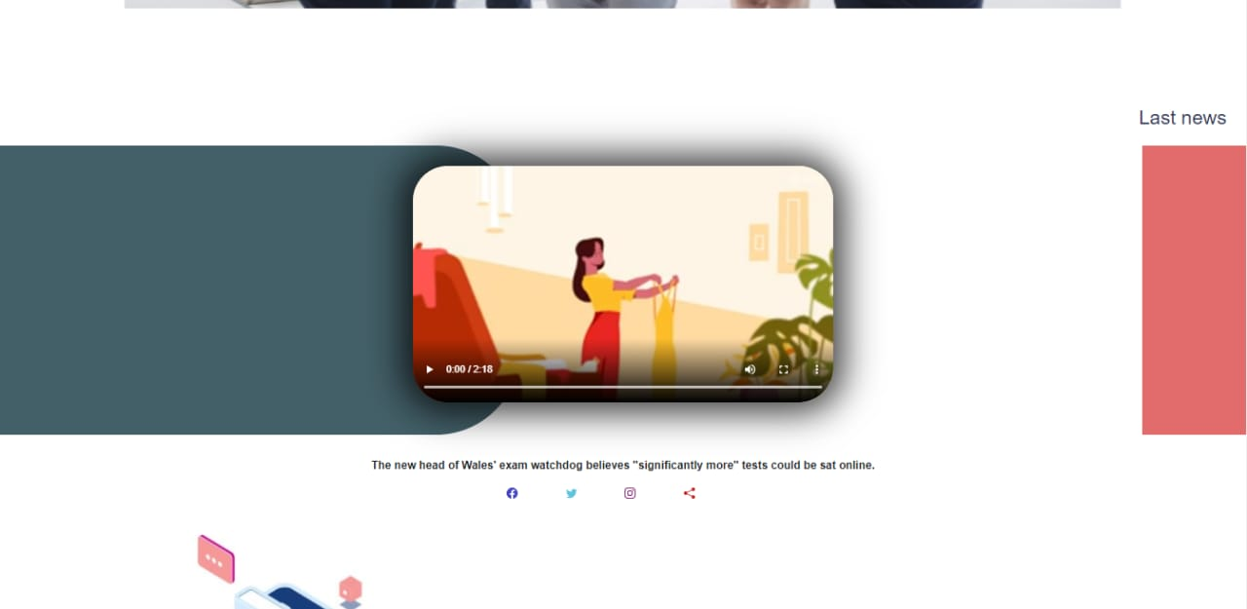

Home : which is for general info about website

Slide 4


faculty : direct to faculty index page which have all faculty in our website
→ each faculty have:
- home : describe this faculty and give simple info for it
- student : list of all student
- department: list of all department
- staff: list of all staff
trianing: this page any student or guest can make training exam put this
not store in database;

Slide 5
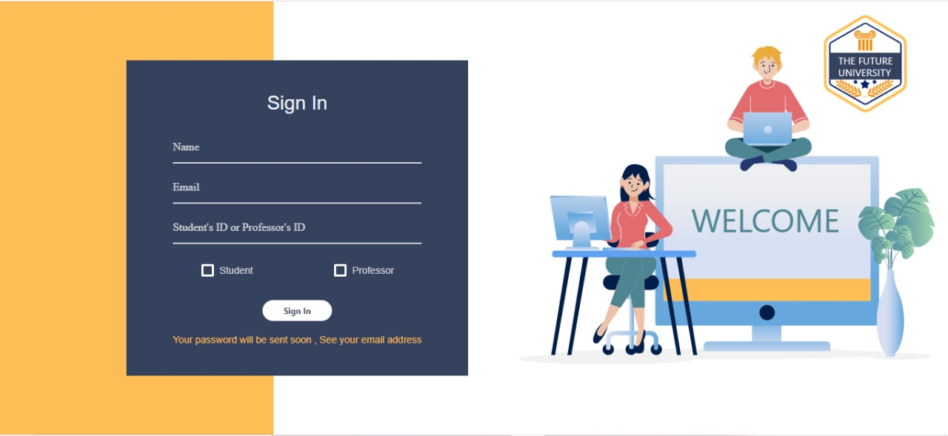
login
signup : divided into two page
- id verification: after verified go to next which is
- complete account info: after complet student or prof now have an
account can access with it in login page.

Slide 6
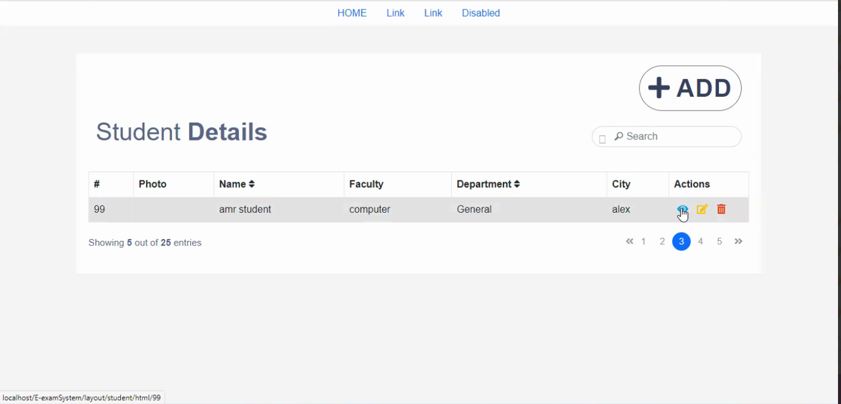
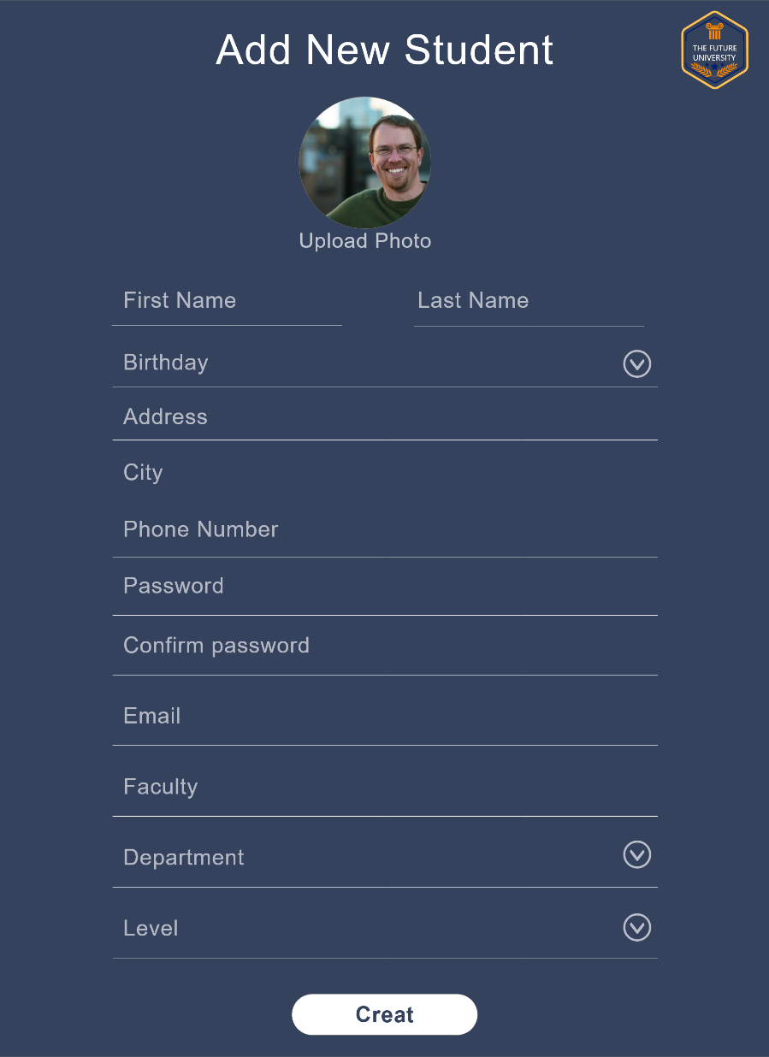
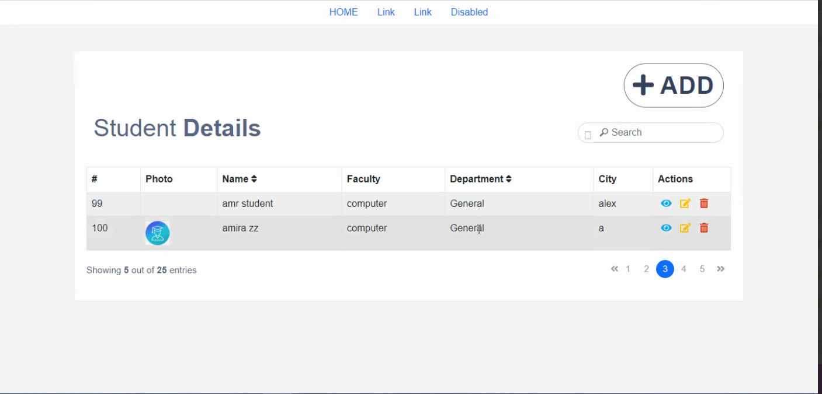
_{Admin’s Page}
Step1
Step2
Step3

Slide 7

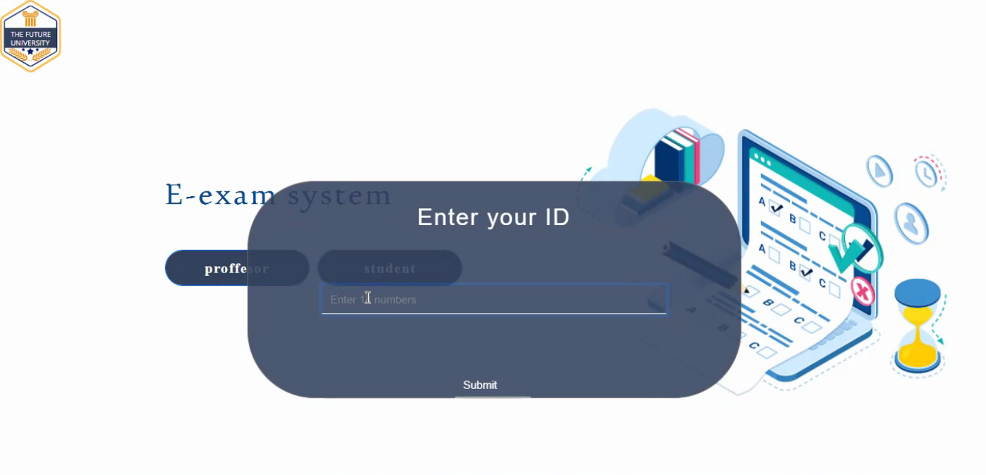

Slide 8
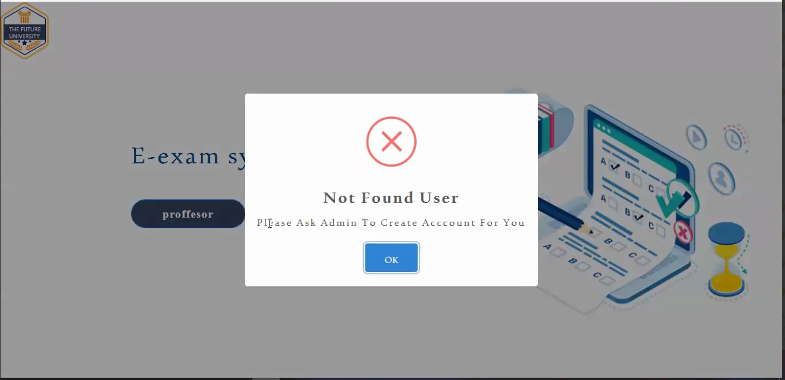
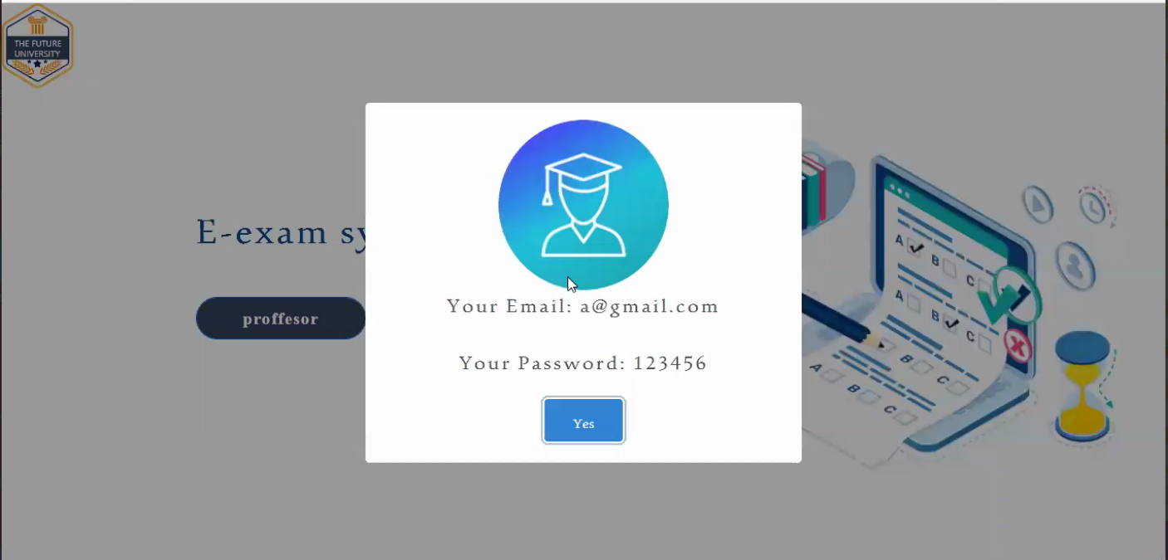

Slide 9
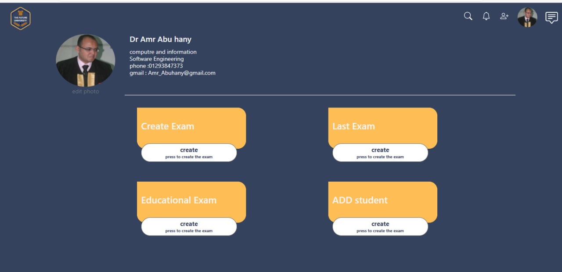
Doctor’s Profile

Slide 10
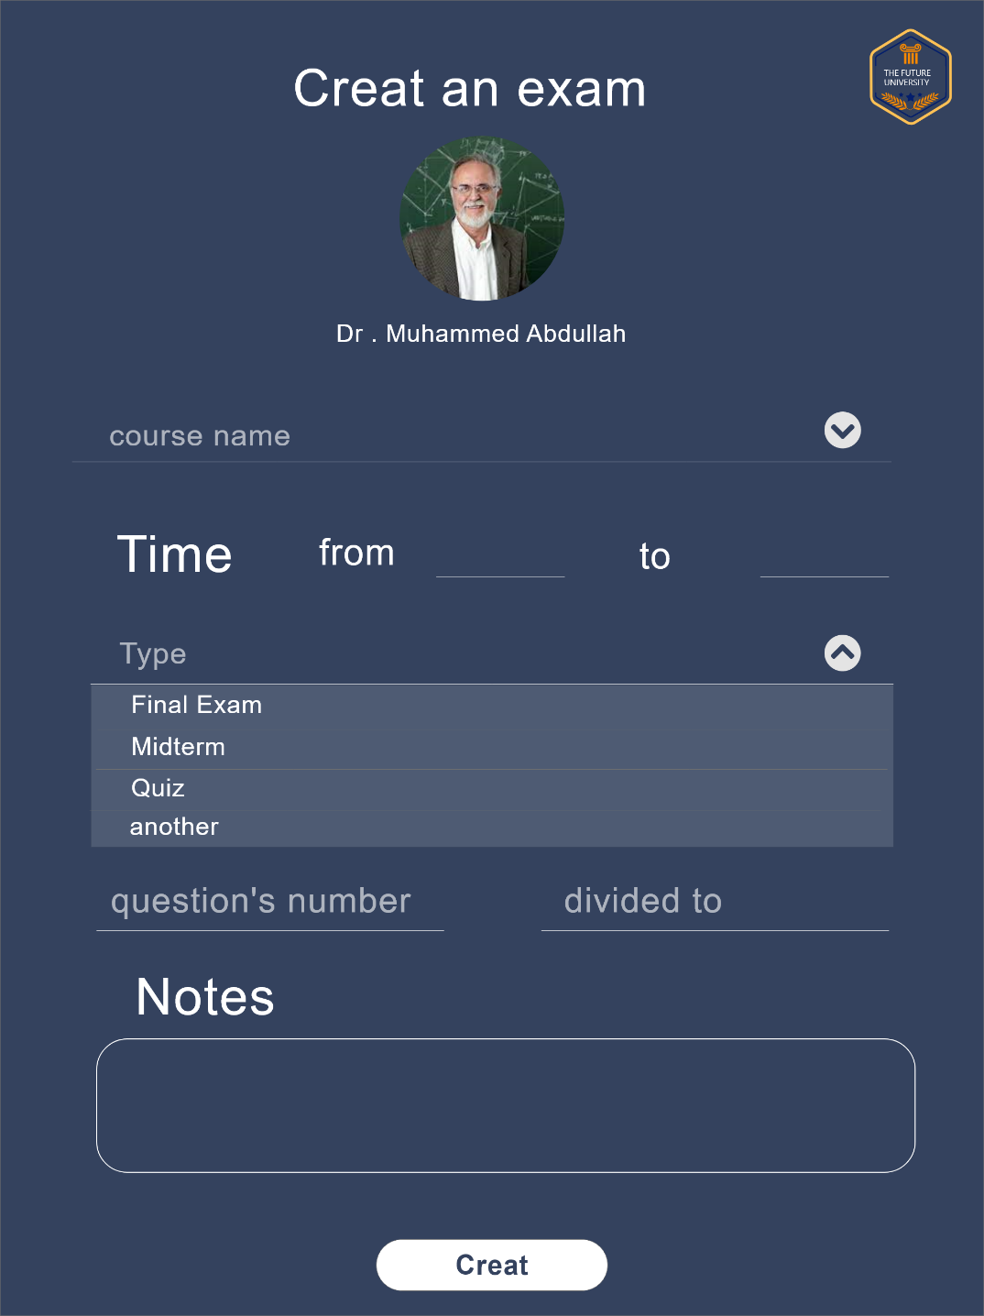
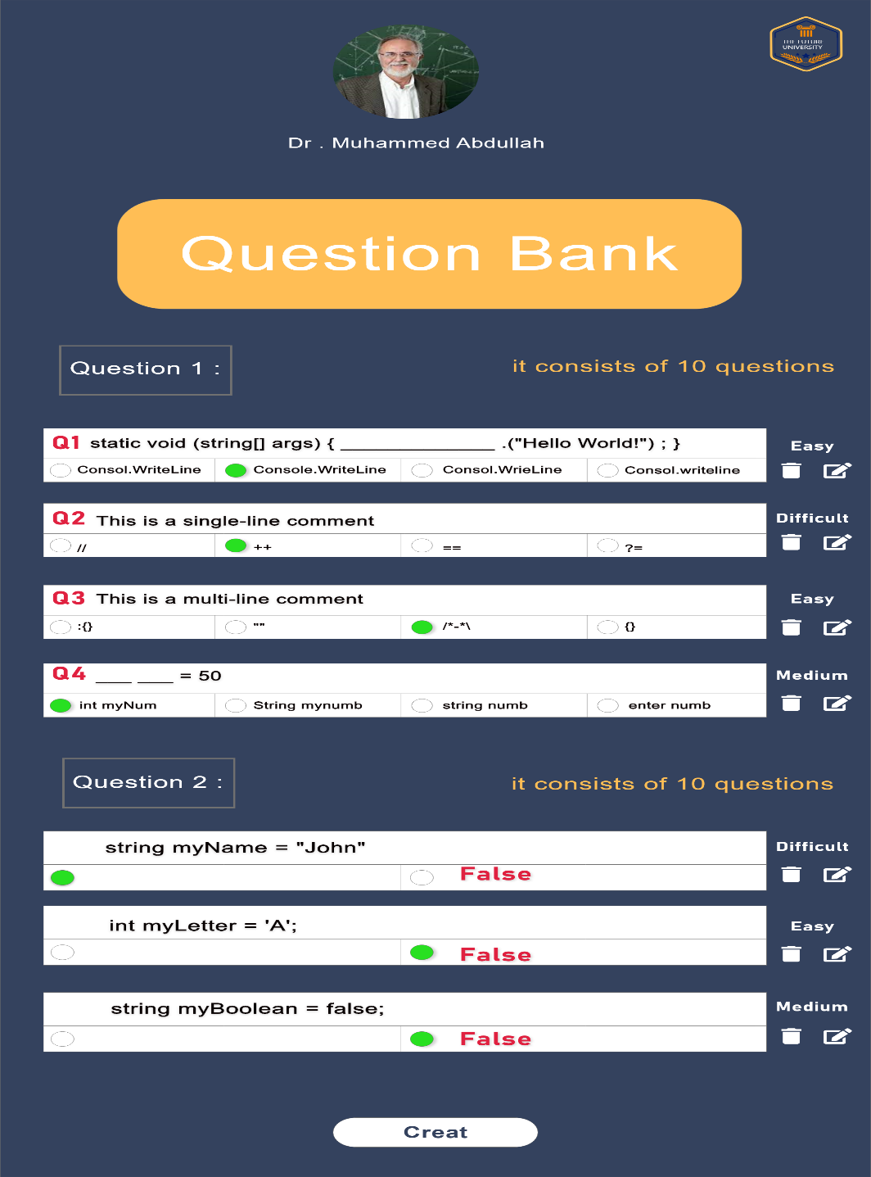

Slide 11
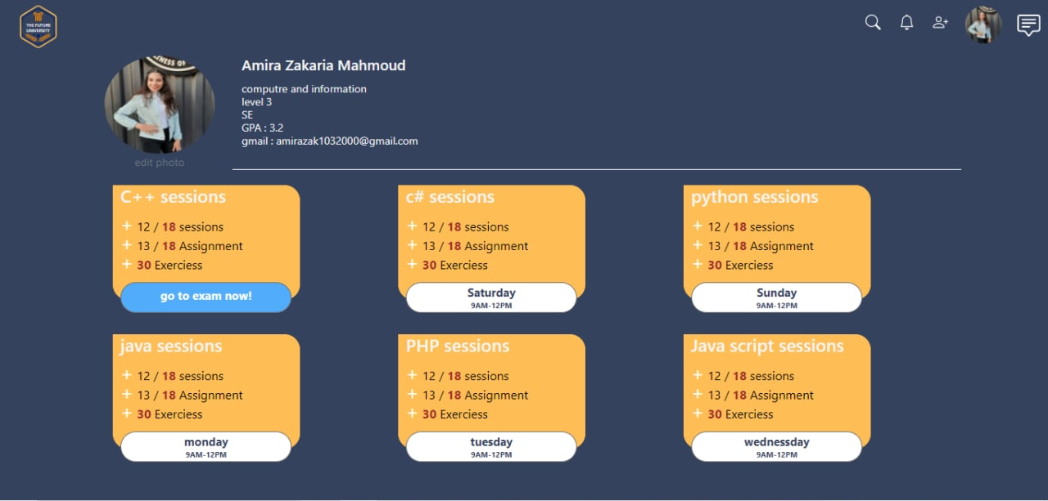
Student Profile :

Slide 12
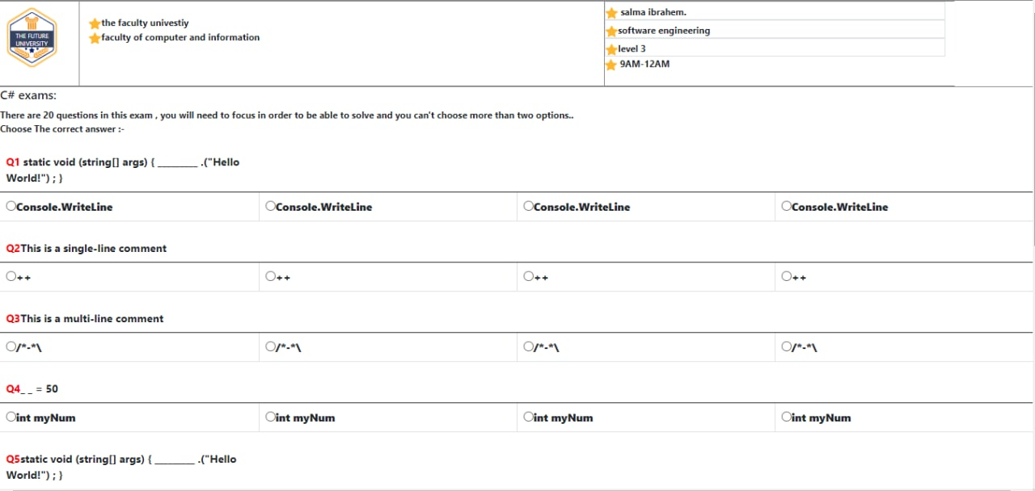
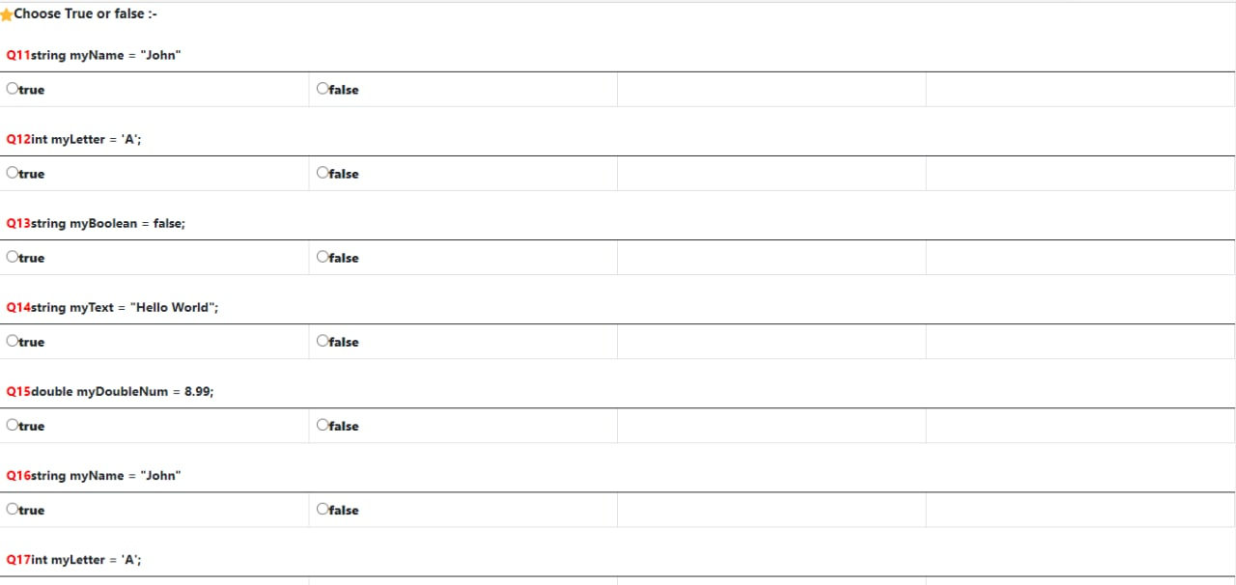
The student exam

Slide 13
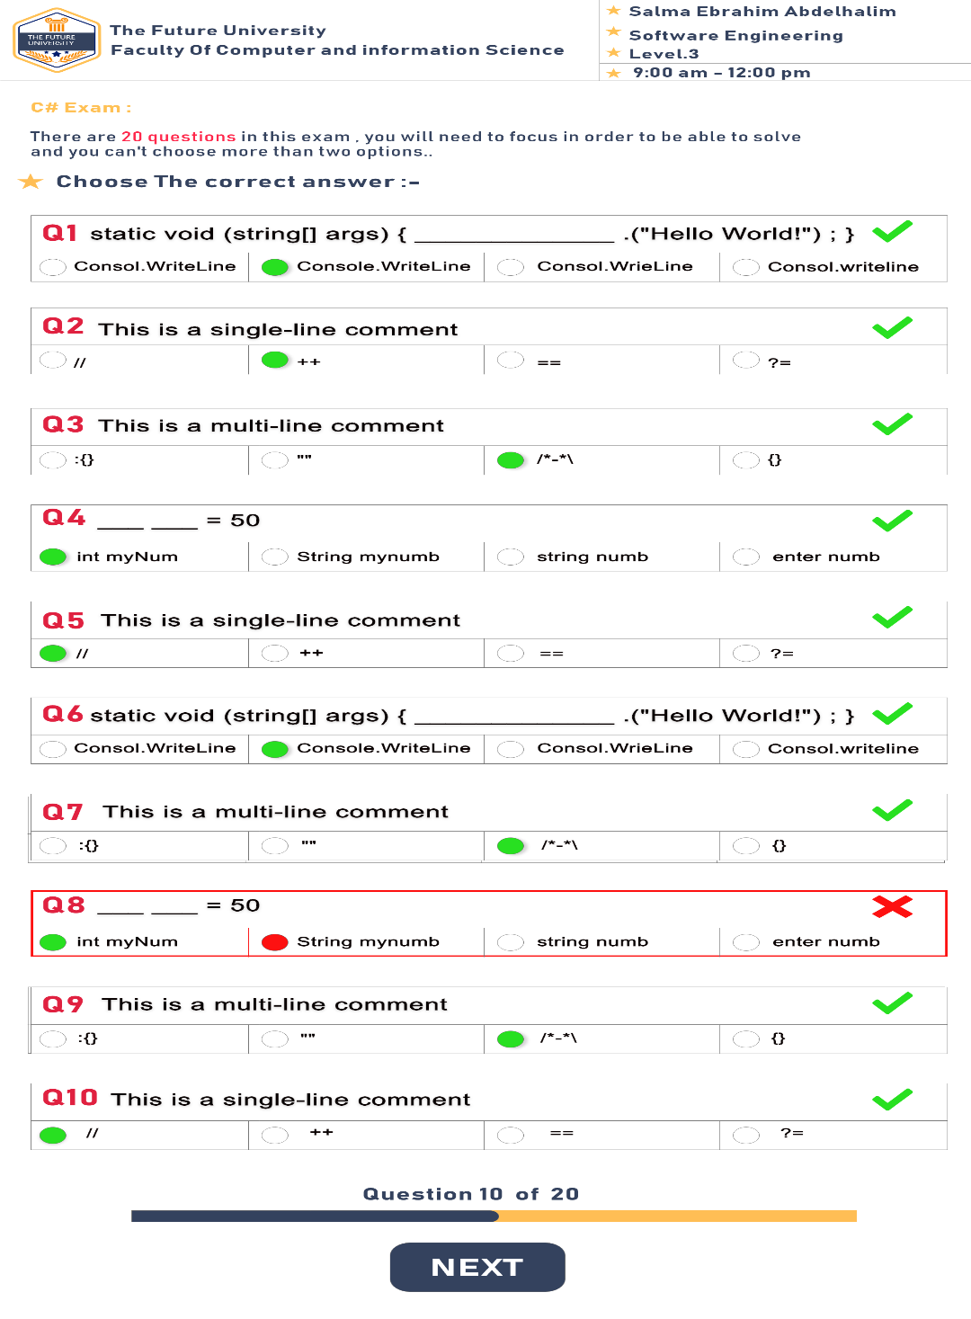
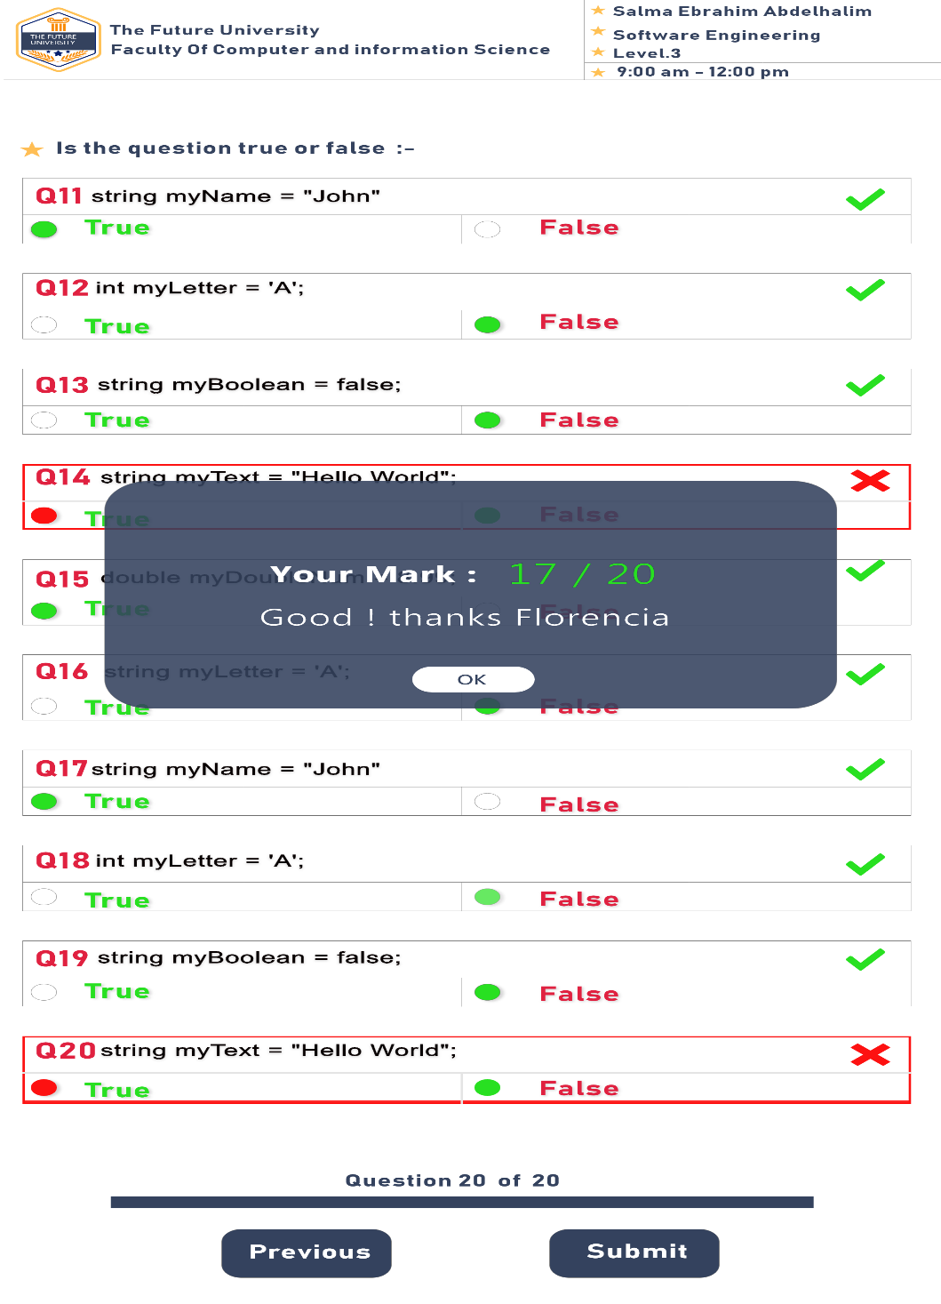

Slide 14
